Slide 1
IANS & nsna membership benefits
Iowa Association of Nursing Students (IANS)
Membership Director: Sydney Aitchison

Slide 2
Link between Ians & nsna membership
The Iowa Association of Nursing Students (IANS) is the state association that bridges the gap between you and the Nations Student Nurses’ Association (NSNA).

Slide 3
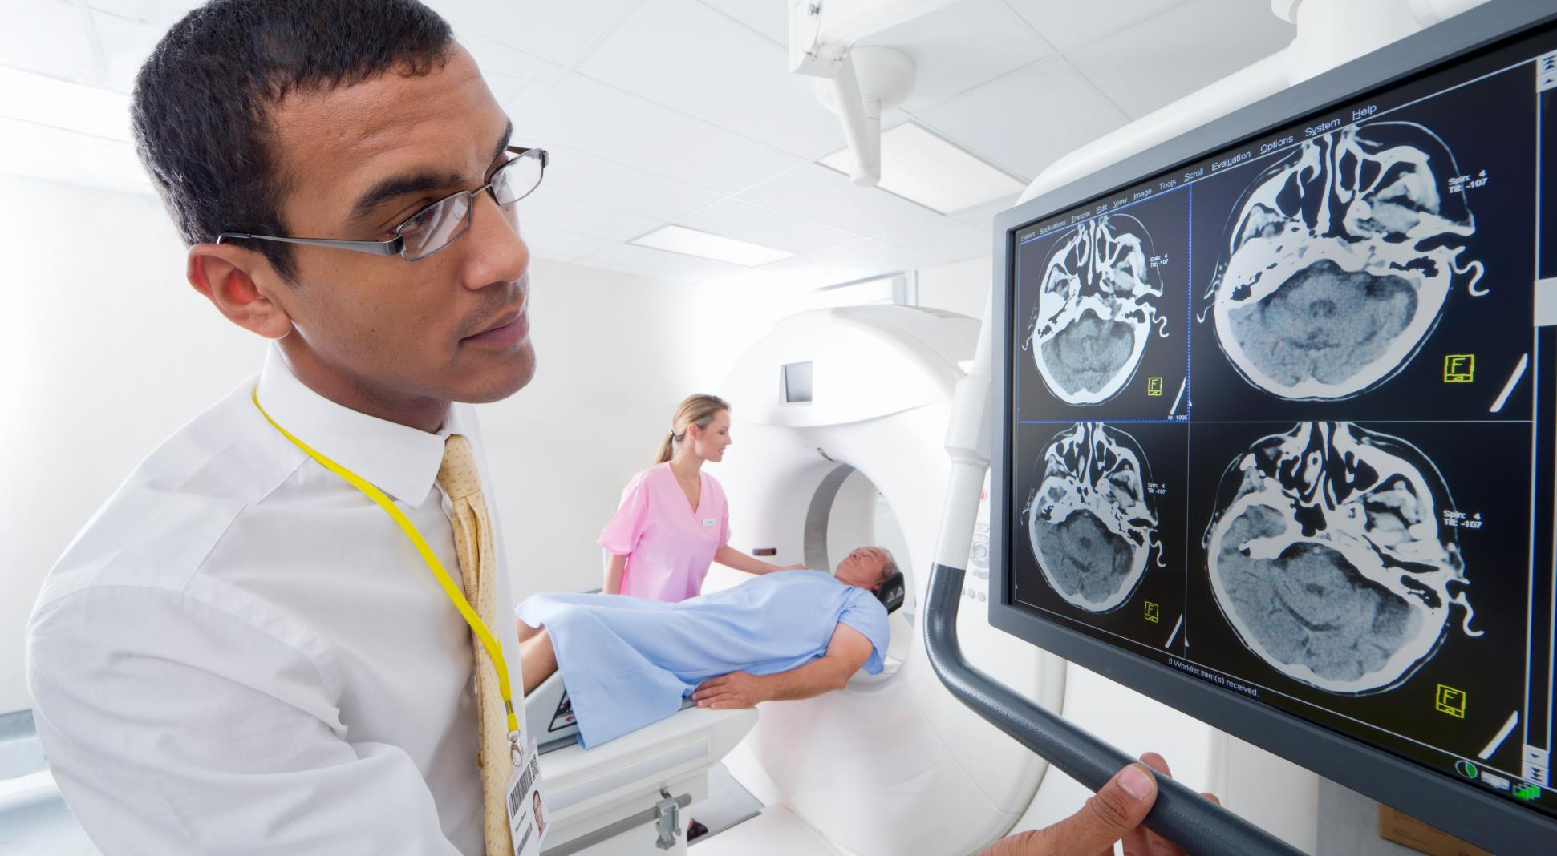
Nsna & ians membership
network
Mentorship
Advocate
Development
Leadership
Attend annual state IANS and national NSNA conferences and connect with nursing students throughout the country
Build relationships with peers through insightful discussion and shared experiences within healthcare
Present legislature promoting high quality patient care and advancements in nursing education
Broaden scope of nursing practice and professional values
Elect annual Executive Board of Directors
Advancement Opportunities

Slide 4
Additional Benefits
Scholarship Program
Professional Liability Insurance
NCLEX Preparation
Breakthrough to Nursing Scholarship and Student to Student Scholarship. More information can be found here:
http://www.iowanursingstudent.org/scholarships.html
Nurse Service Organization. $35.00 per year for students. Allows 1 million dollars per occurrence up to 6 million annually. Eligible for 50% discount after graduation for first year.
25% discount on WoltersKluwer NCLEX-RN study tools. State convention hosts break out sessions for NCLEX preparation and review.
Transportation Discounts
Scrub and Uniform Discounts
15% discount at Red Roof Inn Hotels
10% discount at Motel 6
7% discount at Thrifty Car Rentals
10% discount at Scrubs & Beyond
10% discount at Uniform City

Slide 5
NSNA Conference 2021
Date, Time & Location
Breakout Sessions
Networking
Date: April 5-10 2021
Time: schedule linked below:
Annual Convention Schedule.pdf
Location: Zoom Vitrual Format
Breaking Down Barriers: A Virual Experience
NCLEX Mini Review
Career Development Center
Skill and Workshop Sessions
Keynote Speaker: Susan B. Hassmiller, RN, PhD, FAAN
Experience in public and community health
Endnote Speaker: Teresa “Tese” Maggard Stephens, PhD, MSN, RN, CNE
Experience in education and research

Slide 6
Registration for 2021 NSNA Conference
Requirements
School has at least 10 NSNA members on February 10, 2021
Complete Chapter Delegate Credentialing Form for each allotted delegate attending convention
Deadline
11:59 PM April 6, 2021
School Chapter Delegate Credentialing Form
Online 2021 Delegate Credentialing (jotform.com)

Slide 7
IANS Conference 2021
Date & Location
Theme
Networking
More information to come regarding
Keynote Speaker
Breakout Sessions
Expected Attendance
Registration information
Date: Monday September 20th
Location: Zoom Virtual Format
Diversity in the Nursing Profession
Highlight different avenues one can explore when graduating with a BSN

Slide 8
Resources
Iowa Association of Nursing Students (IANS) Website
http://www.iowanursingstudent.org/
National Student Nurses’ Assocation (NSNA) Website
https://www.nsna.org/
2021 NSNA Conference Delegate Resources
https://www.nsnaconvention.org/delegate-resources.html
Delegate Credentialing and Electronic Voting 2021.pptx
Constituency and Delegate Information.pptx

Slide 9
Thank you
Sydney Aitchison
Membership Director
mdofians@outlook.com
Iowa Association of Nursing Students

